Slide 1


Company: Shivansh Enterprises
Director: D Karade
Shivansh Enterprises is authorized distributor and applicator for Elantas BeckIndia Ltd and Sika India Private limited.

Slide 2
Aim-Vision
Our aim/mission is to deliver the best in the class quality of work and on time delivery and make sure the client is not only satisfied but also delighted with the results.
Our Vision is to be among the leading applicators in India.
Our relationship not only remains with the clients till the execution of the projects, but we make sure to give the maintenance-service to our clients on call basis as and when required.

Slide 3
Scope of Work
• Industrial Flooring
• Coving
• Food Grade Epoxy Coating
• Protective/Interior Wall Coating
• Waterproofing
• Marine Deck Covering
• Structural Repair
• Building Maintenance Work

Slide 4
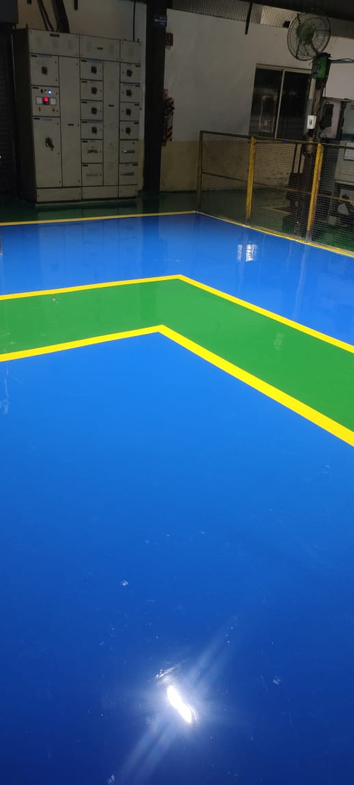
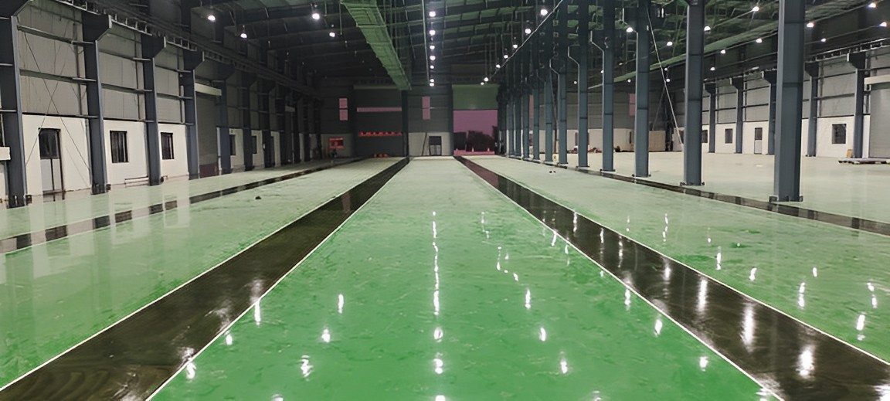
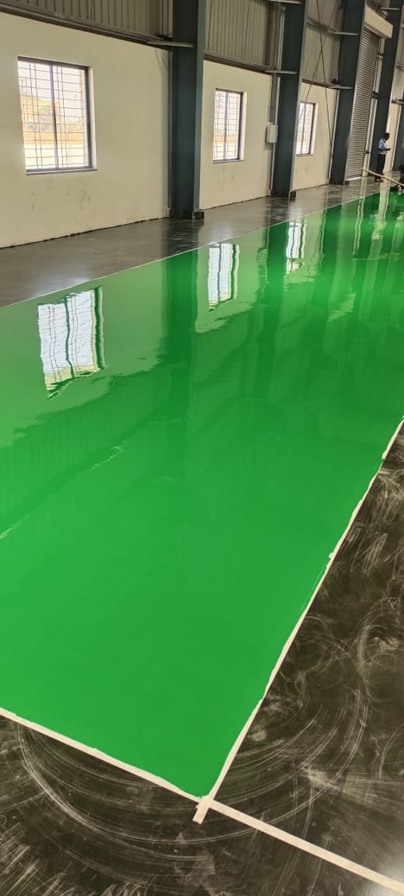
Sample Executions

Slide 5
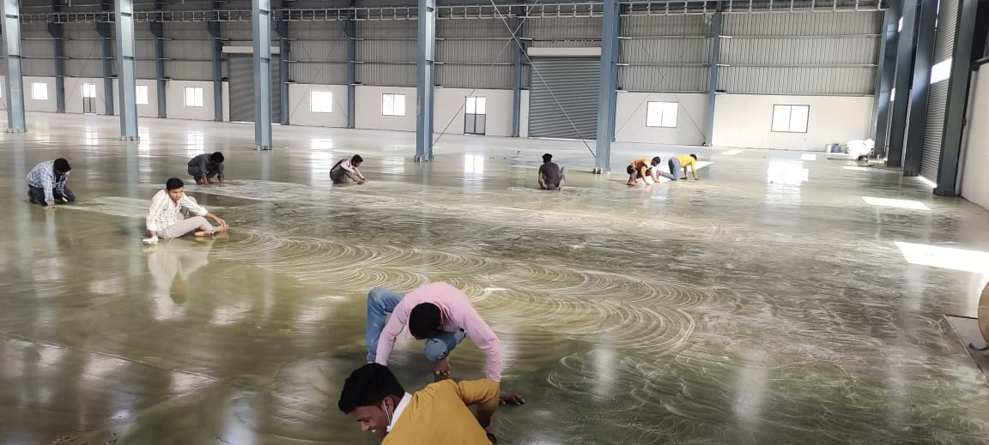
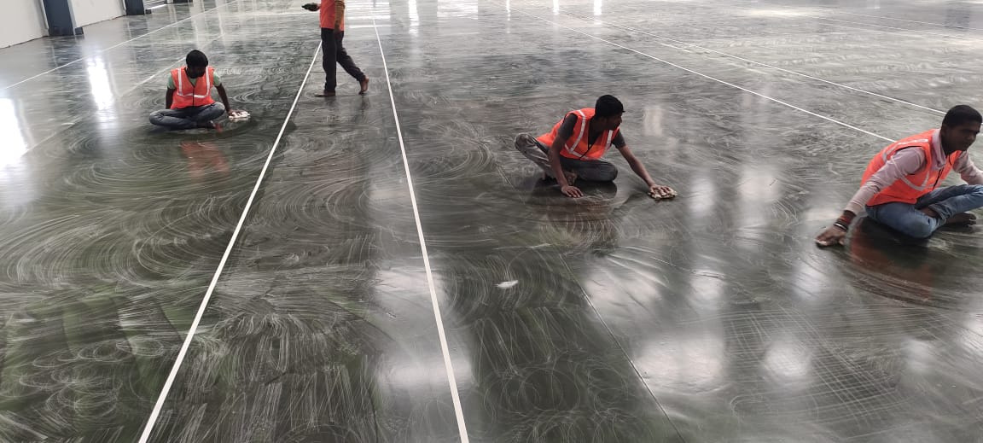
We have a well trained team of 90 technicians to get the best of the results in the
projects we execute.
They are a well trained team, who are trained at our authorized dealer facilities to get the best of the skills.

Slide 6
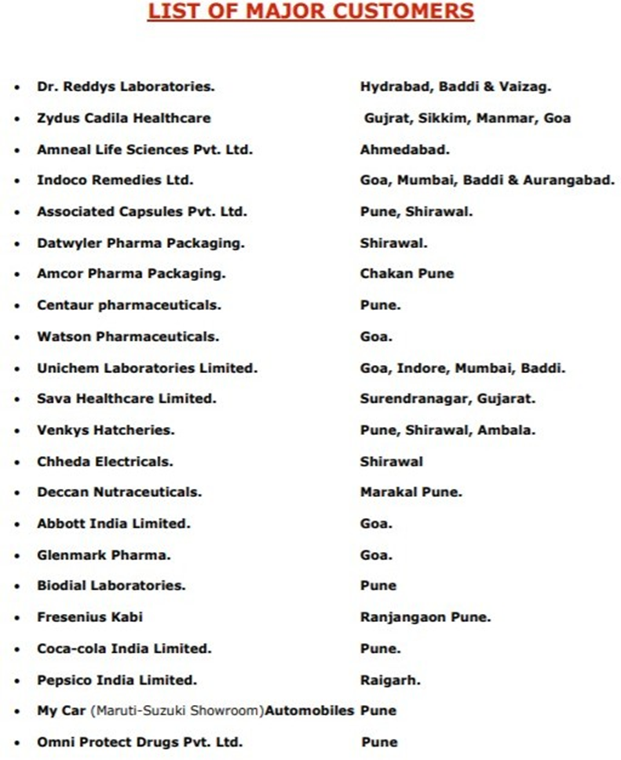
Experiences
.
In last over ten years we have carried out many major projects for Pharmaceuticals, Food, Automobile and Engineering industries
Following are some of our key clients, with whom we have worked to the utmost satisfaction results over a period o decade;
Samvardhana Mother-son Sumi
Kalyani Techno Forge Ltd.
Renata precision IND.pvt.Ltd
Aditi Pharma Ltd.
Kalyani Transmission pvt.Ltd
Grippo Eoat IND Pvt Ltd

Slide 7
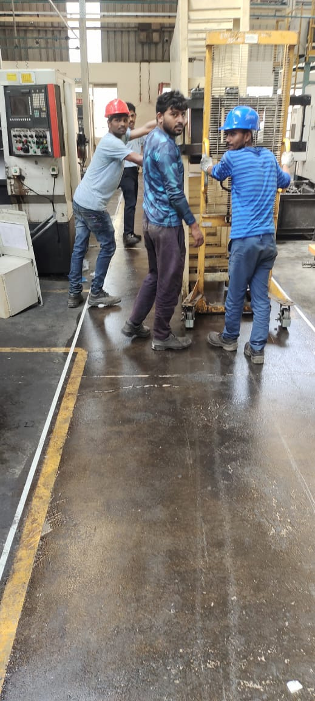
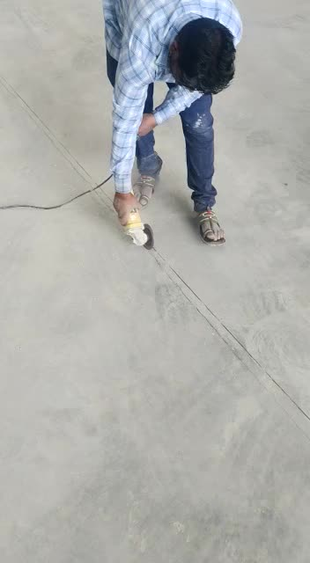
Flow of Work
Grinding
Groove Cutting

Slide 8
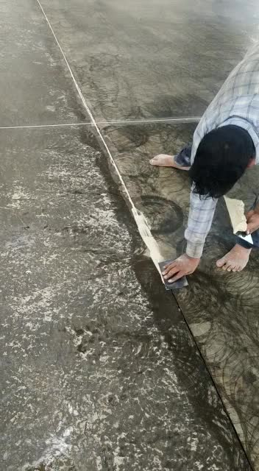
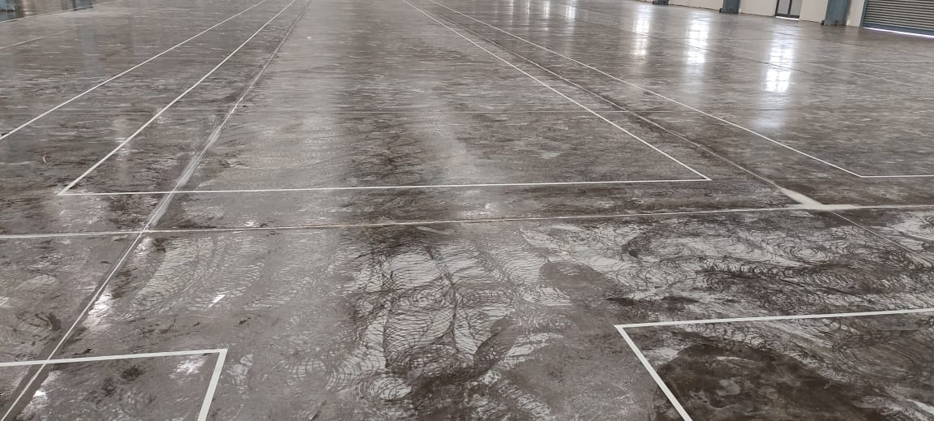
Groove filling
Primer

Slide 9
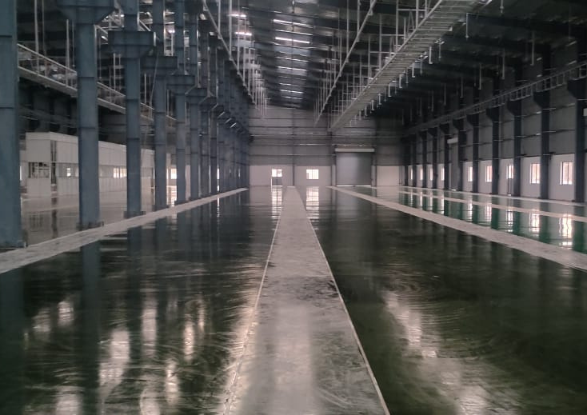

Screeding
Epoxy flooring top coat

Slide 10
Get In Touch
Office Address:
Petals C – 102, S. No. 194/1 – 04, Kaspate Wasti,Wakad, Near Sonigara Kesar, Hinjewadi, Pune – 411057
Email:
shivanshent@yahoo.com
Mobile:
+91 8830077200/ +917830902199

